Slide 1



Air Quality Index (AQI)
Prediction Model
Air quality is vital for health and the environment. The Air Quality Index (AQI) reports daily air
quality. It measures pollutants like ozone and particle pollution. The EPA (Environmental Protection Agency) is the source for this data.
BY Prashant Kumar
(prashantpacific53@gmail.com)

Slide 2
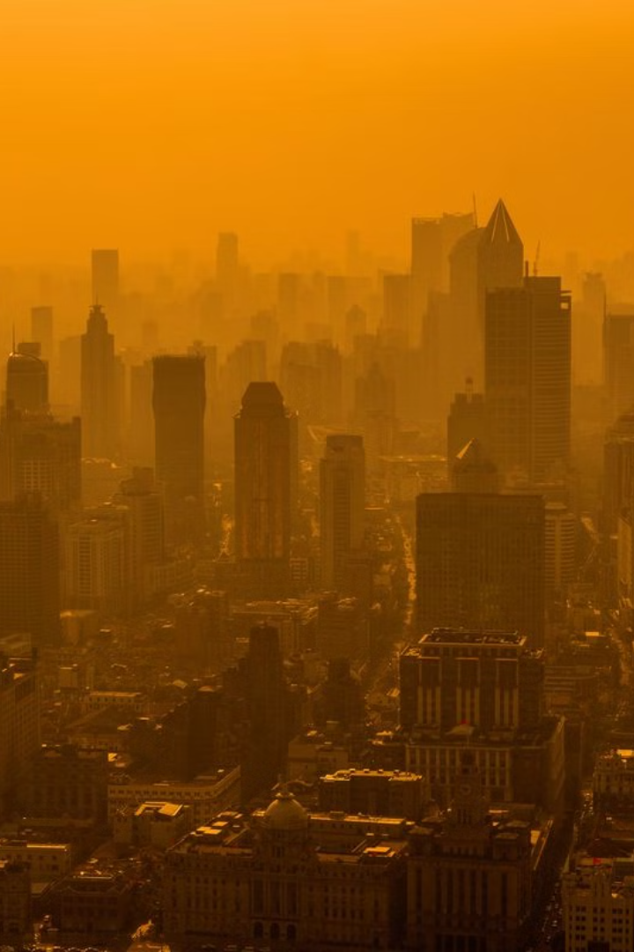

Learning Objectives
1
Understand AQI
Grasp the concept and importance of the Air Quality Index.
2
ML for Prediction
Discover how machine learning predicts air quality.
3
Explore Techniques
Learn data preprocessing, training, and evaluation methods.
GOAL
4
Real-World Insights
Source :
www.freepik.com/
Gain insights into AQI prediction applications.

Slide 3




Tools and Technology used

Slide 4





Methodology
Data Collection
Collect AQI data from sources like CSV files or APIs.
Include pollutant levels (PM2.5, PM10, NO2) and weather factors.
Data Preprocessing
Handle missing values and remove duplicates.
Normalize and clean data for better analysis.
Exploratory Analysis
Visualize AQI trends using Matplotlib & Seaborn.
Identify correlations between pollutants and weather.
Model Training
Train regression models for AQI prediction.
Evaluate performance using RMSE, MAE, and R² score.

Slide 5
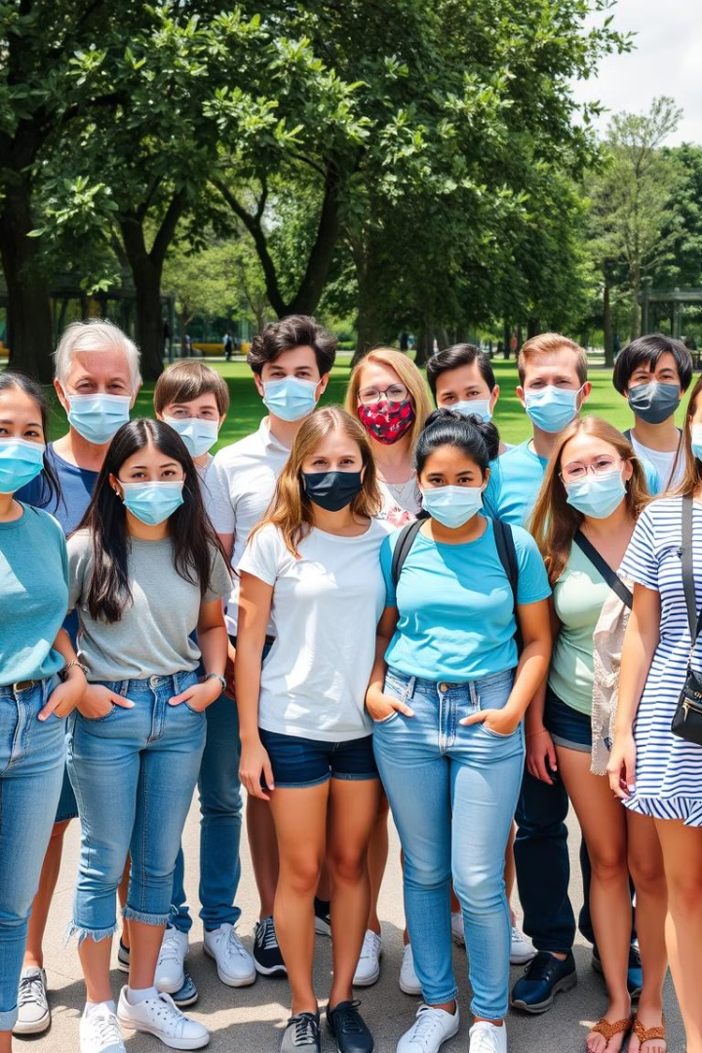
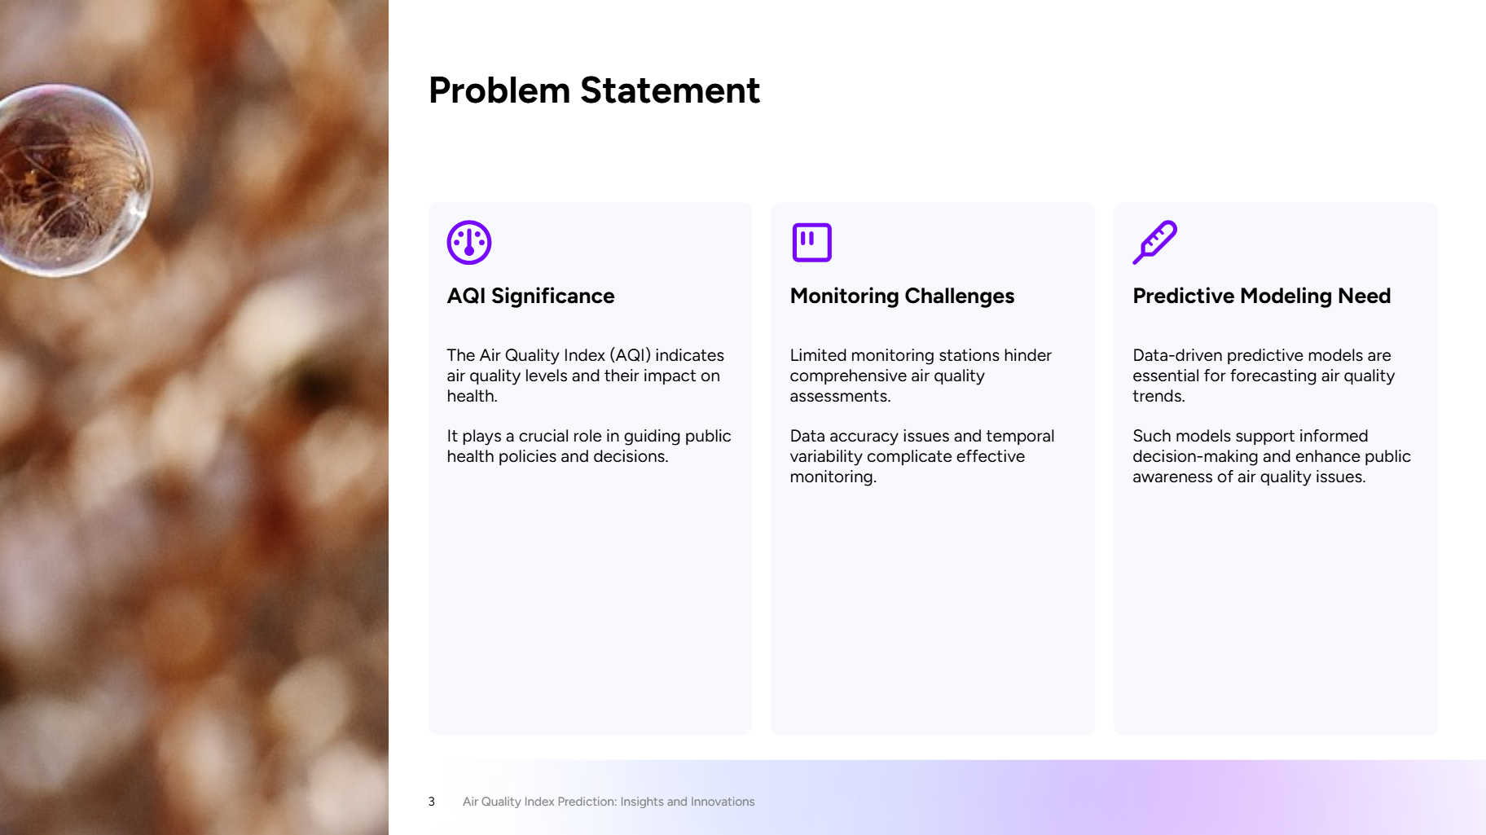




Problem Statement:
Who Is Most at Risk?
Cardiovascular Diseases
Elderly
Respiratory Diseases
Children
Sensitive groups include children, the elderly, and those with respiratory or cardiovascular diseases. They are at higher risk due to developing lungs or weakened immune systems. Source: American Lung Association, WHO data.

Slide 6
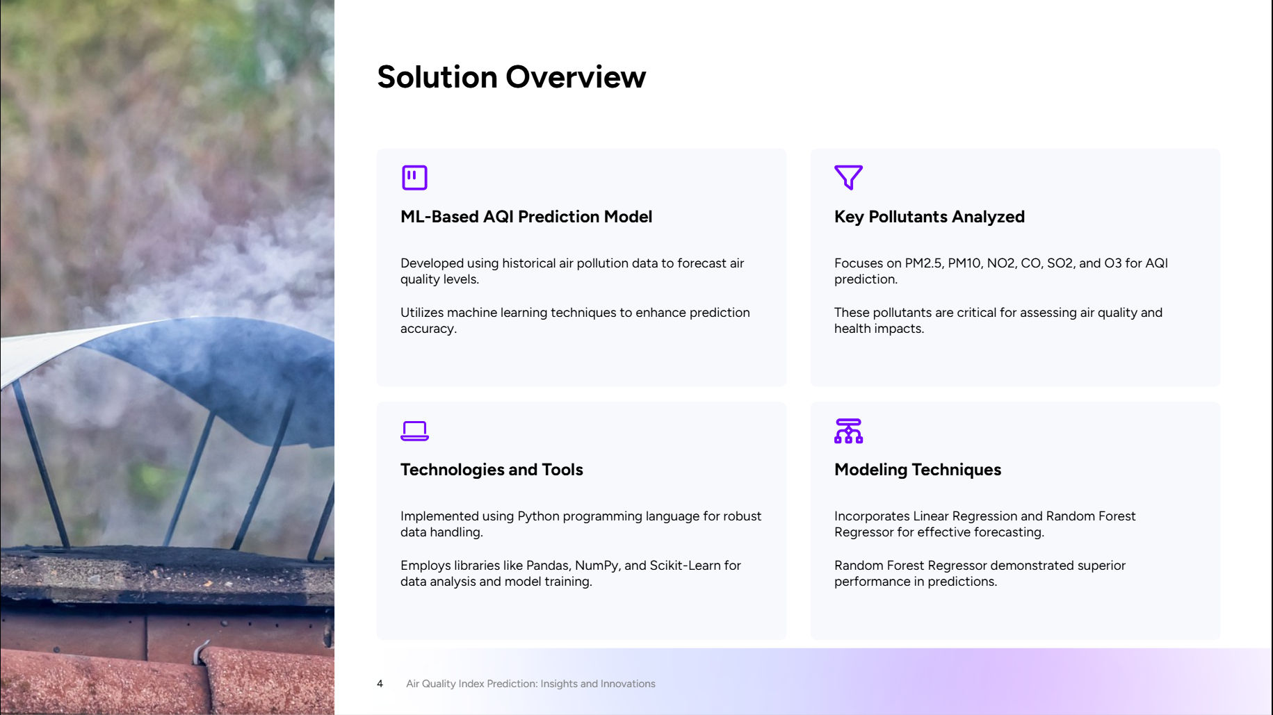
Solution:
ML-Based Model
AQI Prediction Model uses historical data.
Key Pollutants
Analyzes PM2.5, PM10, NO2, CO, SO2, O3.
Tools
Uses Python, Pandas, NumPy, Scikit-Learn.
Algorithms
Implements Linear Regression & Random
Forest.

Slide 7
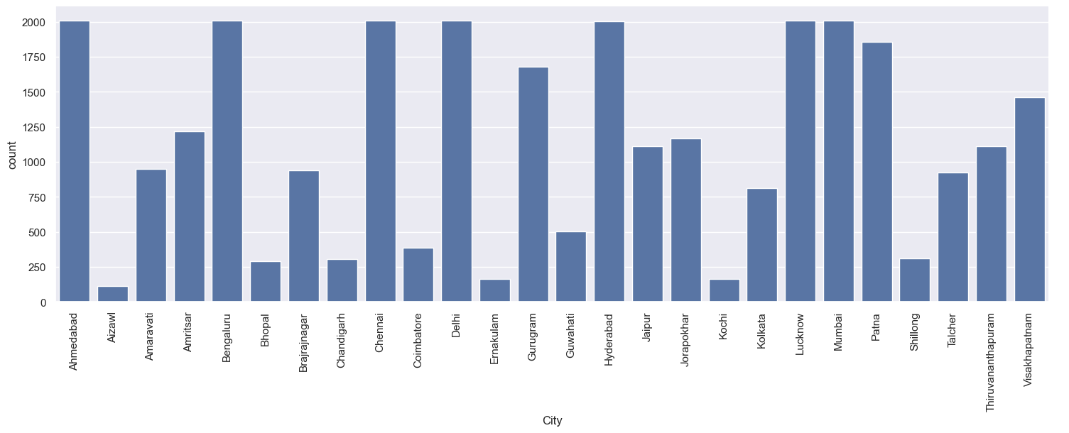
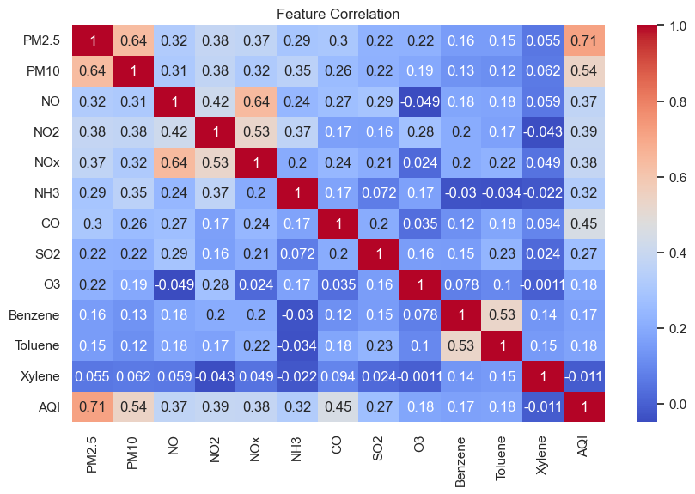
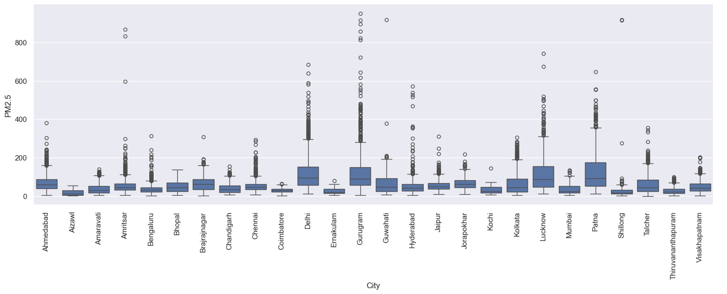
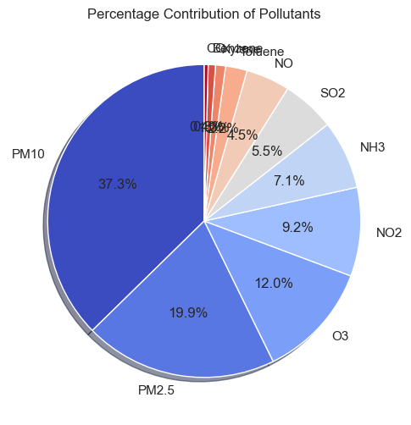
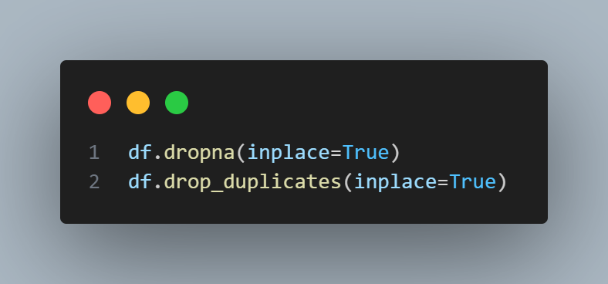
Screenshot of Output:
Feature Correlation by Using of Heatmap
Visualization Of the Data
Data Preprocessing Code
Percentage Contribution Of Pollutants
AQI Prediction of PM2.5

Slide 8
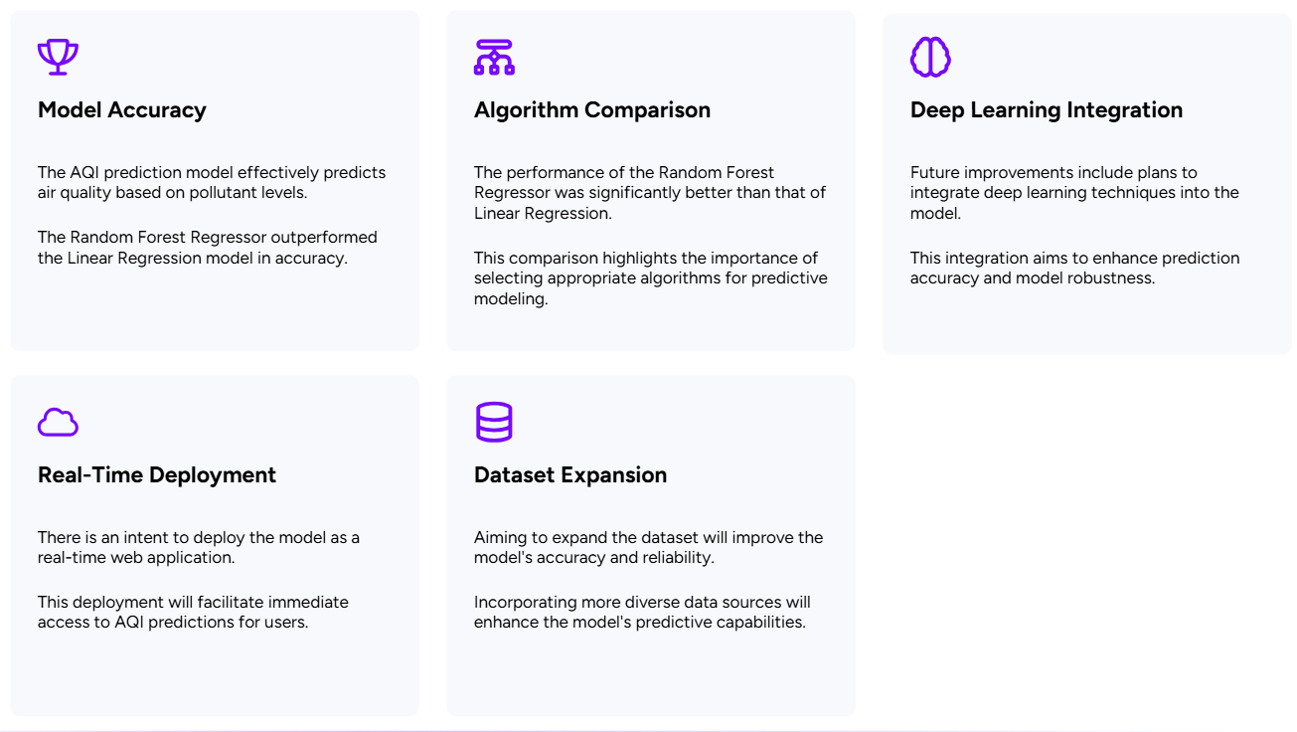
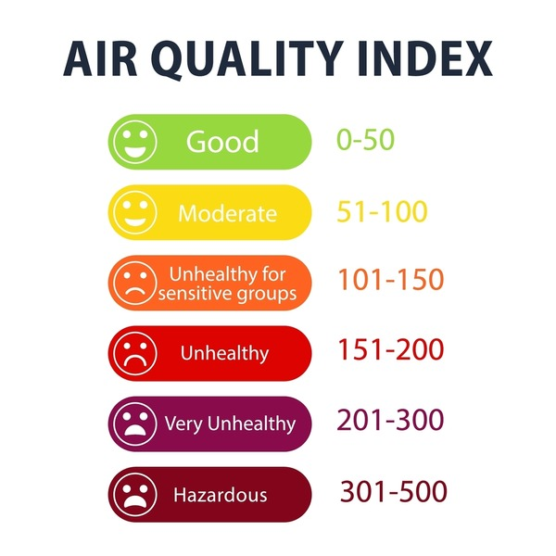
Conclusion:
AQI Level

Slide 9



Acknowledgments
We extend our sincere gratitude to our mentors, collaborators, and the AICTE, edunet Foundation, & Shell for their support and guidance in this project.

